Slide 1



Home alarm system
Embedded System Mini project.

Slide 2
Members: Nguyễn Gia Bảo 2051087 Lý Tùng Thái 2051191 Phạm Gia Khánh 2051132

Slide 3
Table of content:
-Introduction
-Requirements
-Components
-Block diagram
-Workflow
-Demo

Slide 4


I.INTRODUCTION

Slide 5
II.Requirement
Functional requirement
Detect abnormal from surrounding through PIR, IR, Flame sensor
Trigger alarm and light when detect until turn off when command executed
Send message to pc via usb uart
Display current house’s security on LED screen
Able to control full system by computer

Slide 6
II.Requirement
Non-functional requirement
Performance.
Reliability
Usability
Software
Communication
Safety

Slide 7

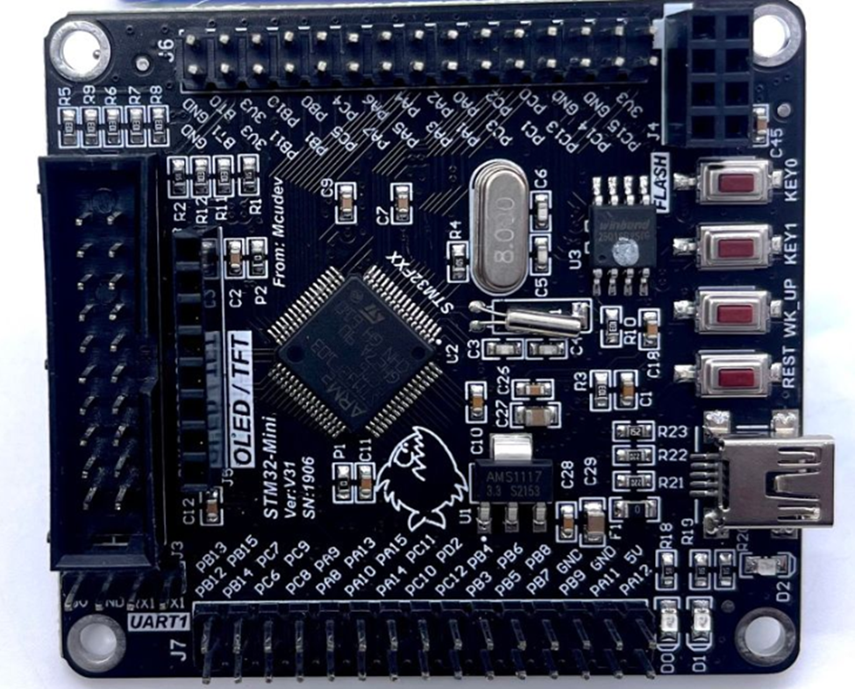
III.Components
STM32F103RCT6 ARM CORTEX-M3 MINI:

Slide 8
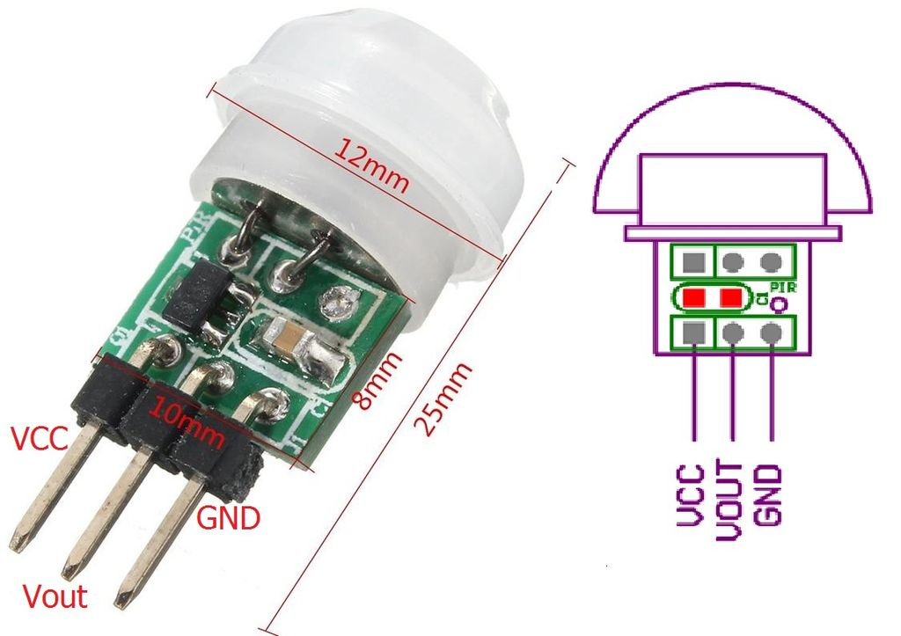
III.Components
PIR AM312 Mini

Slide 9
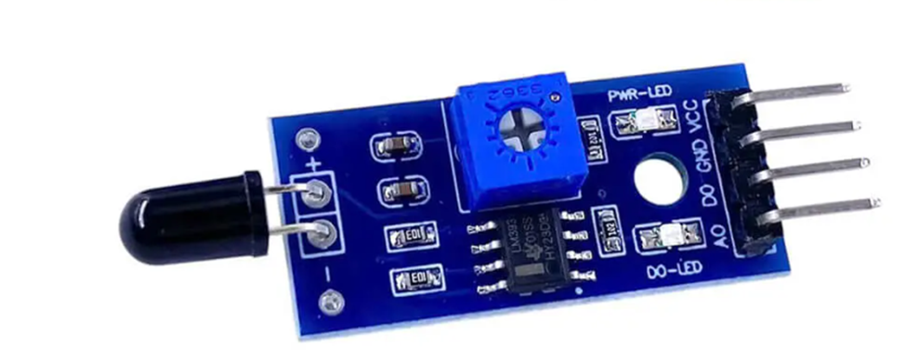
III.Components
Flame sensor

Slide 10
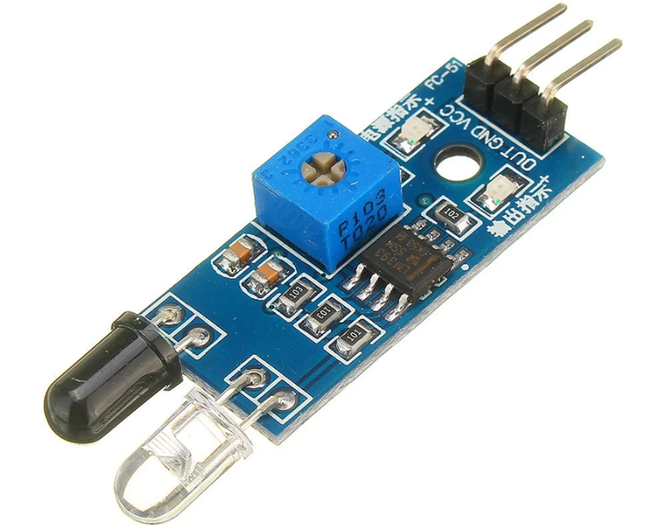
III.Components
IR Infrared Obstacle Avoidance

Slide 11
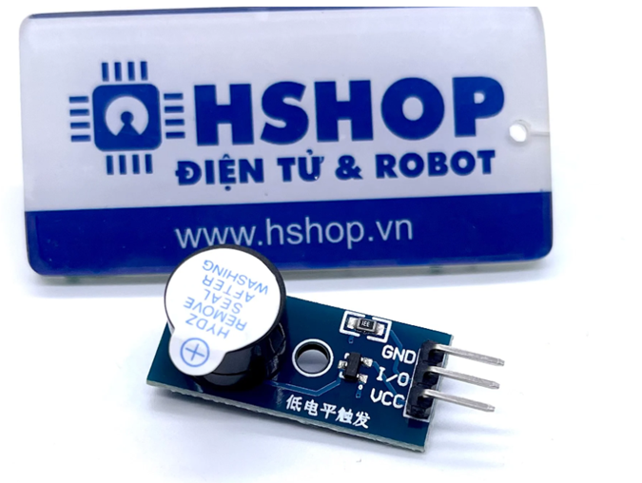
III.Components
Buzzer

Slide 12
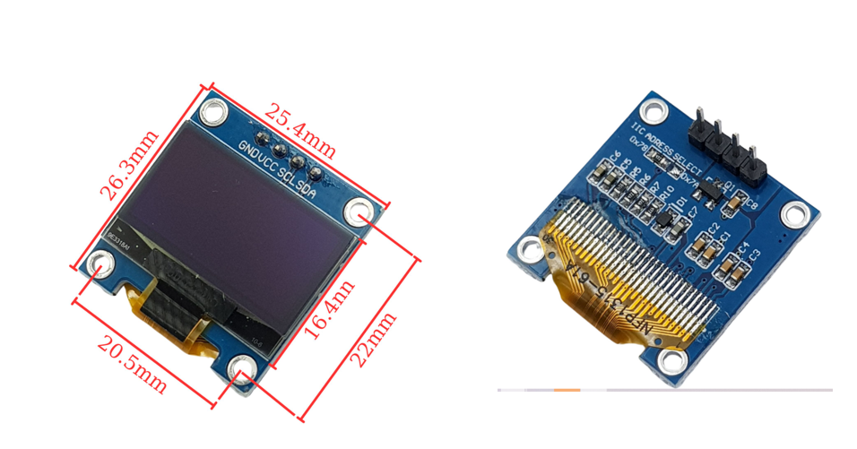
III.Components
OLED 0.96 inch

Slide 13
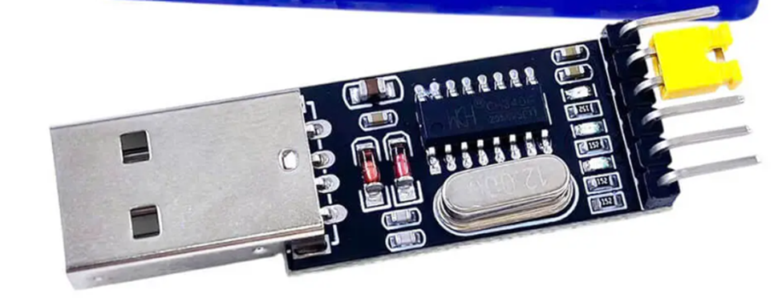
III.Components
The CH340G USB to UART converter circuit

Slide 14
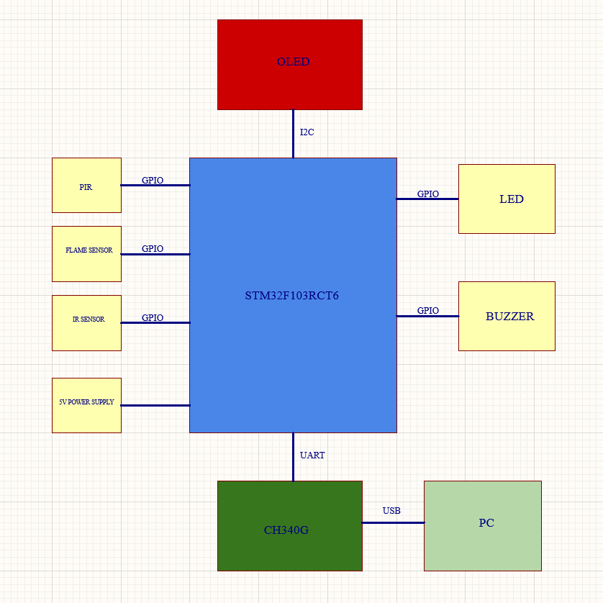
IV. Block diagram

Slide 15
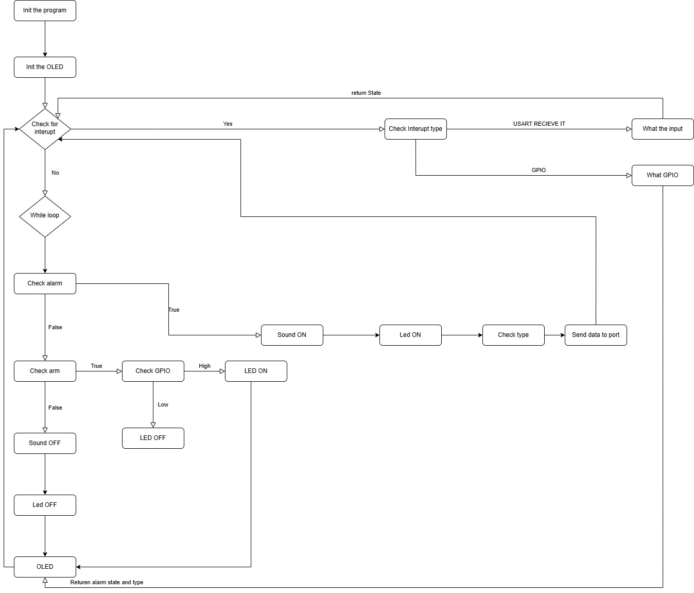
V. Workflow

Slide 16
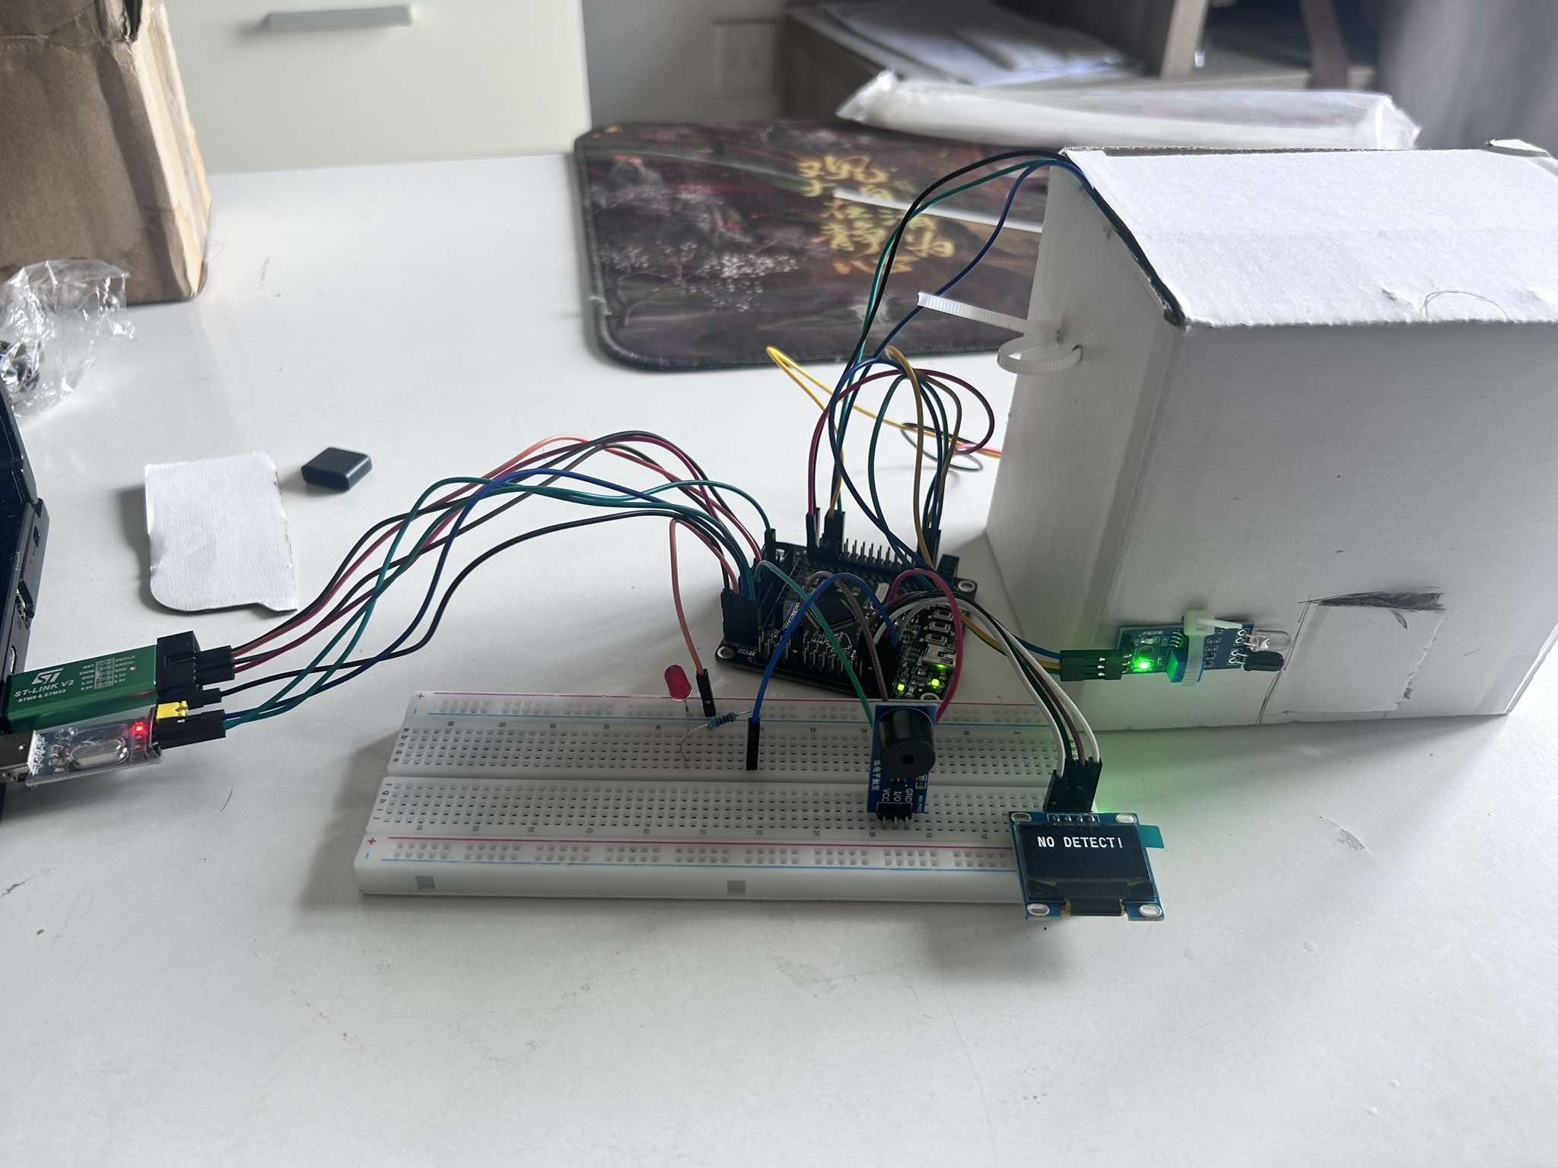
VI. Demo

Slide 17
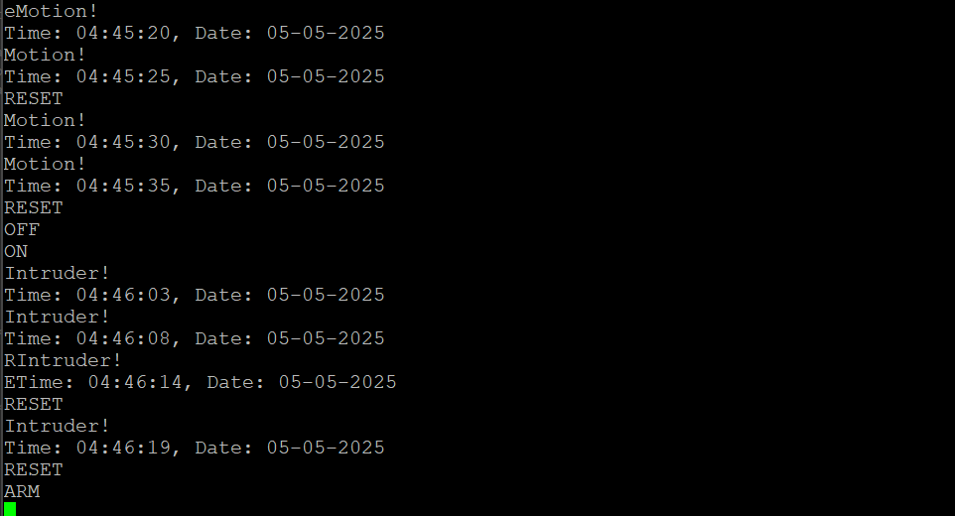
VI. Demo

Slide 18
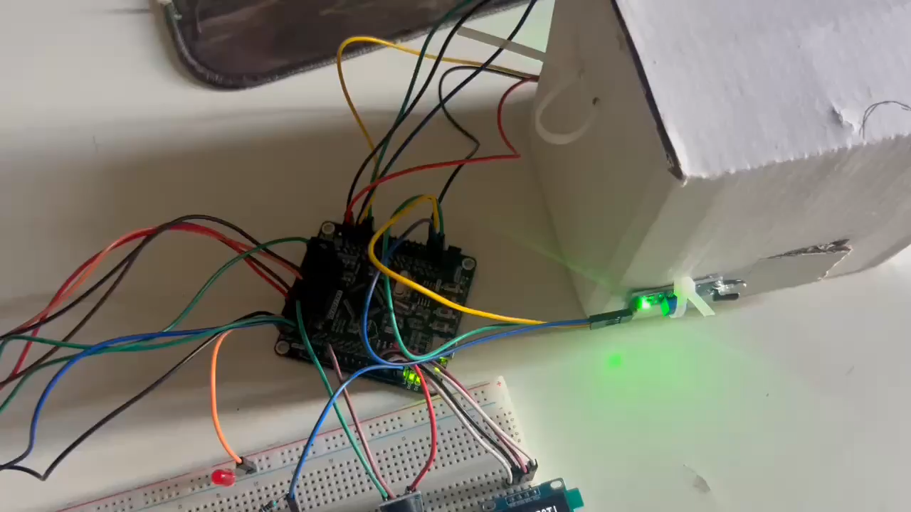
VI. Demo

Slide 19
Thank you for listening

